Slide 1

Online Retail Sales Final Project Paper
Venu Gopalan Krishnagiri Tuppal
11613143
INFO 5709 | Data Visualization and Communication
Instructor: Dr. Gahangir Hossain
Notes:
Greeting,
I’m Venu Gopalan KT and This Presentation is regarding Online Retails Sales as a part of Final Project Paper for
INFO 5709 Data Visualization and Communication

Slide 2
Retail Industry
Generates and Handles lot of data
Online Services are on Demand
Meeting Customer needs
Understanding Preferences
Scope in Future
Notes:
The Industry I have opted for is Retail Industry.
Retail Industry generates a lot of data related to the customers and purchases. Even the smallest thing like a pen or chocolate, when we make a purchase, certain amount of data is generated. For Online, this certain amount has many details can be used analysis. When a customer purchases or browser on the online platform, we can understand what the customer is looking for and provide appropriate offers and services to have a smooth and better business transaction. At the end, main purpose of business is to meet the requirements of customer and satisfy their needs as quickly as possible.

Slide 3
OnlineRetail - Dataset
Source – Kaggle
8 Attributes
Invoice No
CustomerID
StockCode
Description
Invoice Date
Country
Quantity
UnitPrice
Notes:
The data set I have selected if from Kaggle. This dataset is related to an UK based Registered Online Retail Company that mainly deals with all – occasion gifts. The main customers of this firm are wholesalers. This data has 8 attributes that are Invoive Number, Customer ID, Stock Code, Description, Invoice Date, Country, Quantity, and Unit Price.

Slide 4
Data Processing
Use of RStudio
Changing Data Types to Factors
Invoice ID
Stock Code
Description
CustomerID
Changing Country Names
No Replacement for Null Values – Customer ID
Notes:
For this Project, I have used both R, Rstudio and Tableau. For Visualization and Processing in R, I have used Library called dplyr, tidyr and ggplot2 which are part of package tidyverse. The Attributes Invoice ID, Stock Code, Description, Customer ID are actually Categorical data but R by default took it as Strings and Numerical. So, I have changed the data into Factor type that can be used for dividing the categories and plotting efficiently. I have also changed the Country name like RSA to South Africa, Hong Kong to China, EIRA to Ireland, etc.
We have Null values in the Customer ID field. But Customer ID is not numeric data that could be replaced with mean or other values. It is a categorical data that cannot be replaced by other values. So it was left as it is.

Slide 5
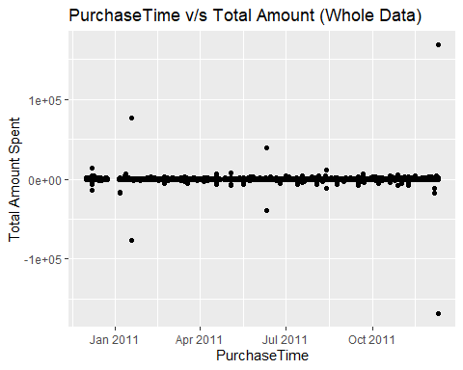
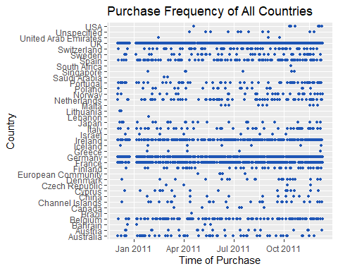
Visualization with R
Notes:
These are the graphs that summarize the Retails for Whole data. On the Left, we have the Total Amount Spent which is Quantity multiplied by Unit Price for whole time period and on the Right we have purchase over time for each country.

Slide 6
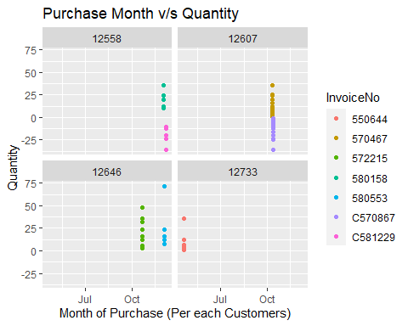
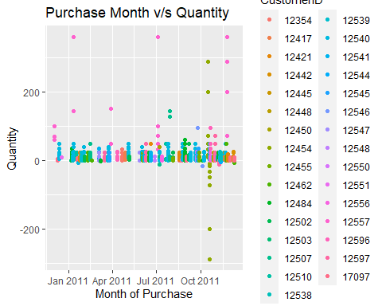
Visualization with R (cont.)
USA
Spain
Notes:
Instead of working on whole data and plotting the graphs that becomes clumpsy, I decided to divide the data based on Countries and plot them individually. On the Left, we have US with approx. 300 Entries. US has 4 customers with a total of 7 Invoices with 2 cancelled Invoice (The negative one are cancelled and Represented with C) and on the Right we have Spain with 3800 entries. Diving it based on Customer ID made the graph hard to read. So I reverted it back.

Slide 7
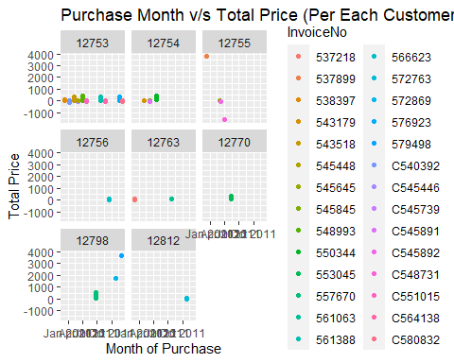
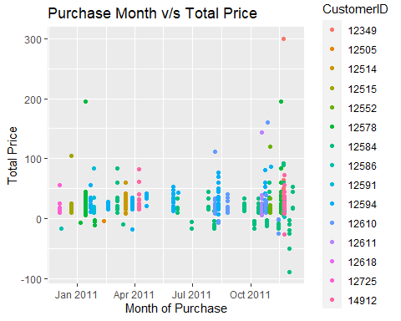
Visualization with R (cont.)
Japan
Italy
Notes:
On the Left we have Japan an example with mid level entry. With Both Customer ID and Invoices with the range, it was possible to plot a graph with facets. Italy had lot of invoices and many entries. So the Graph shows the CustomerID and Purchase Dates

Slide 8
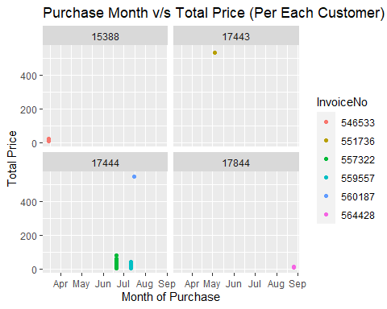
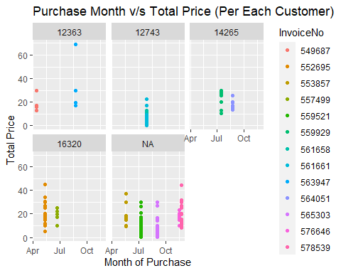
Visualization with R (cont.)
Canada
Unspecified
Notes:
Canada have one of the below average transaction so it was possible to plot the graph diving both Customer and Invoice data. On the Right we have the data for the Countries which were not specified. It the dataset, it was mentioned ‘Unspecified ’ and was not null data. We have Customers ID with Null Data represented as NA at 5th facet of the graph.

Slide 9
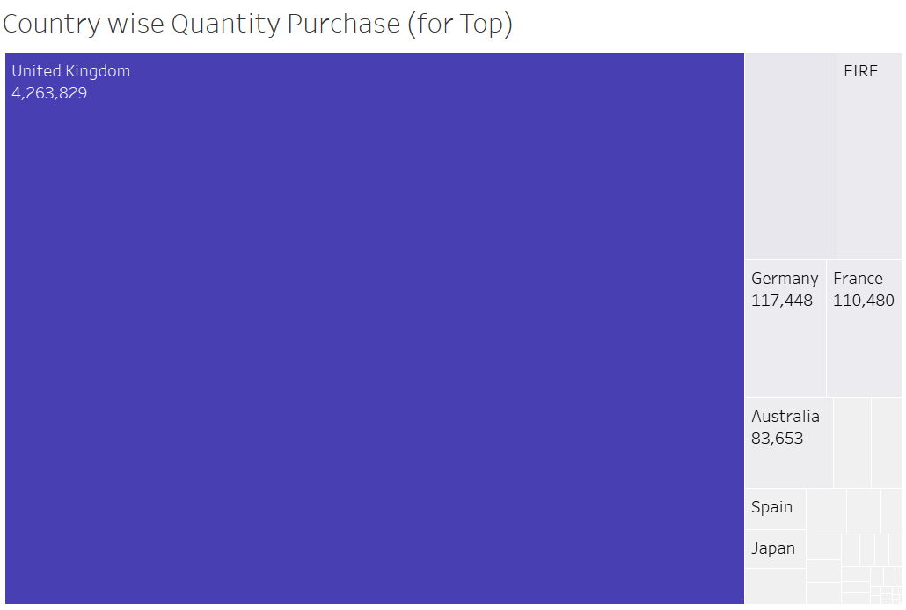
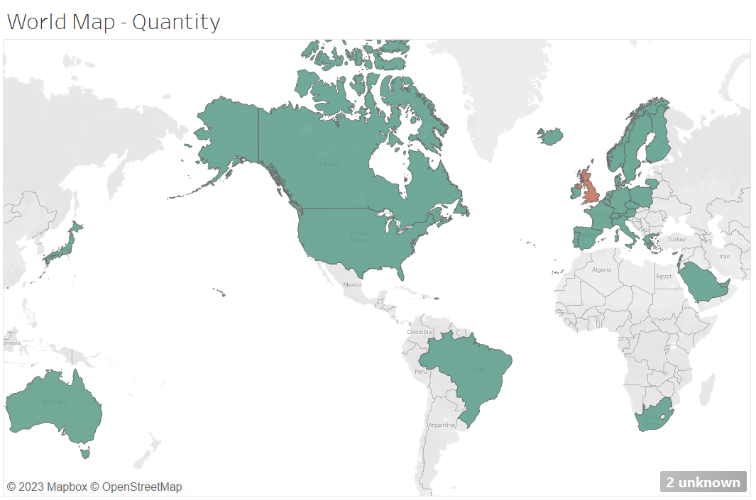
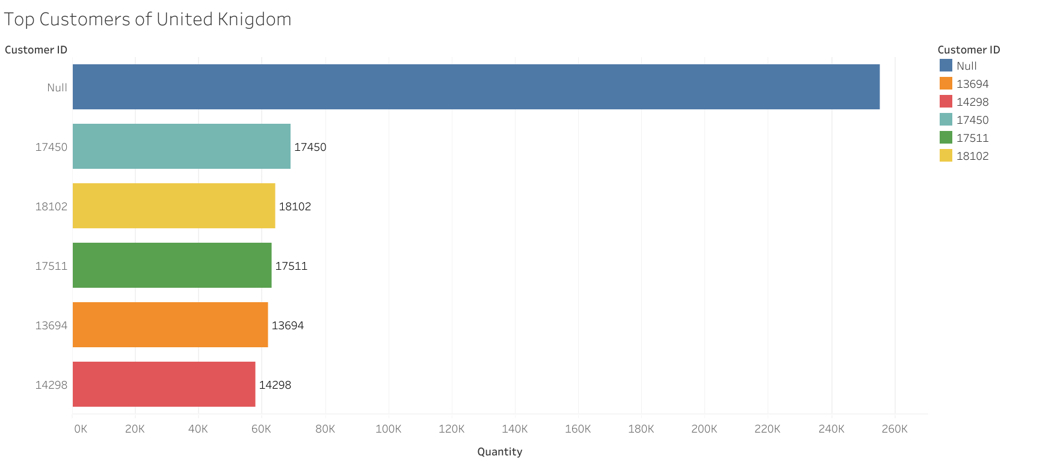
Visualization with Tableau
For getting details on Country with most purchases and other details
Notes:
Now, for the Hypothesis, I have used Tableau. Following 3 Graphs provides result to the First Hypothesis Question reading the Country with Highest Purchase. The World map show the areas where purchases have happened and on the Right we have Square that compare the sales of UK with others with Size representation. The 3rd Bar graph is the list of top 5 Customers and Null Customers from the UK Country

Slide 10
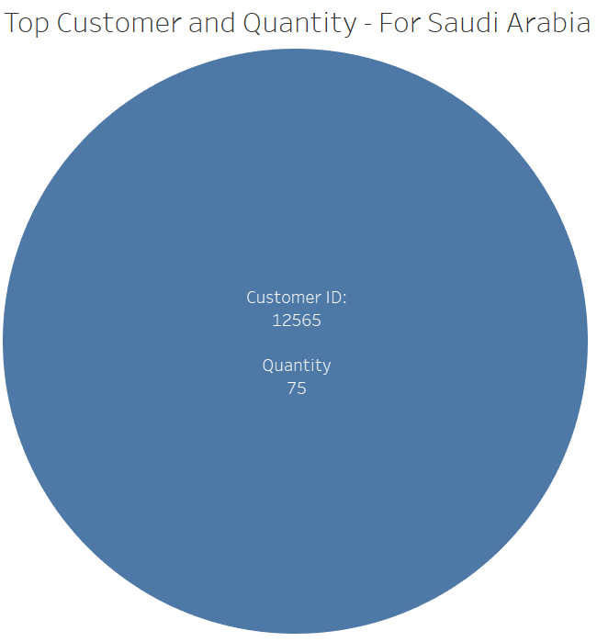
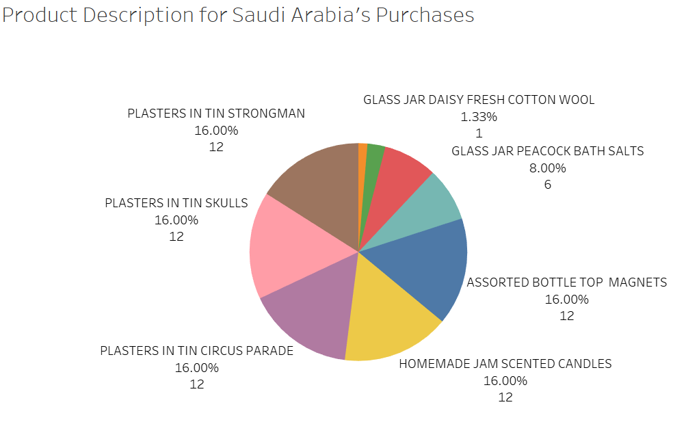
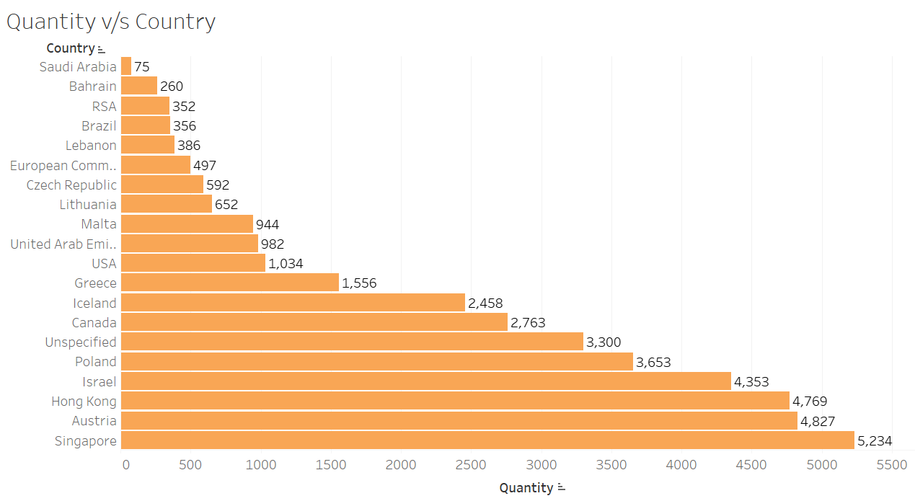
Visualization with Tableau (cont.)
Country with Least Purchase and other details
Notes:
2nd Hypothesis focuses on Country that made least Purchases. The Orange Bargraph represent the List of Quantity Purhcares made by the Countries from the Bottom. Saudi Arabia was the least with only 75 as quantity. The Blue Pie chart shows the only customer that has made purchases with the Purchase Quantity. The Pie Chart on the Right gives you the description of the products that were purchased by the customer with their count and %

Slide 11
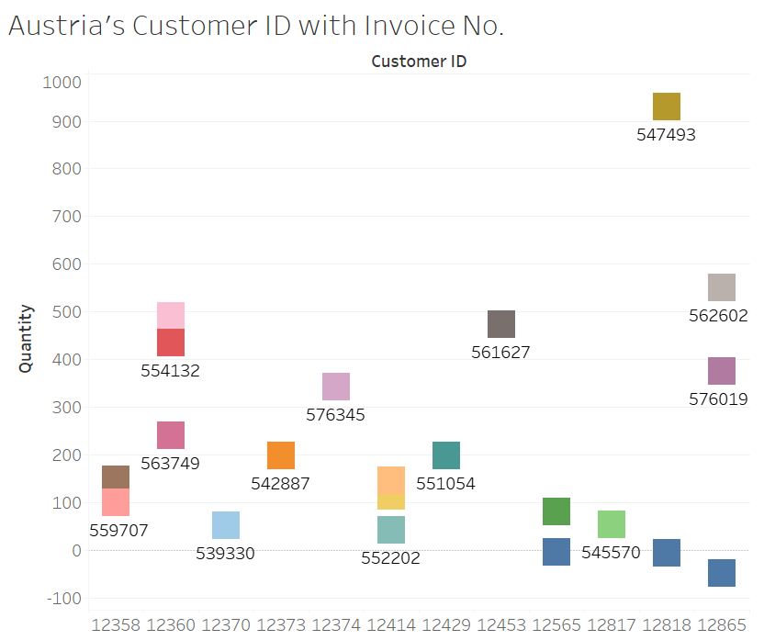
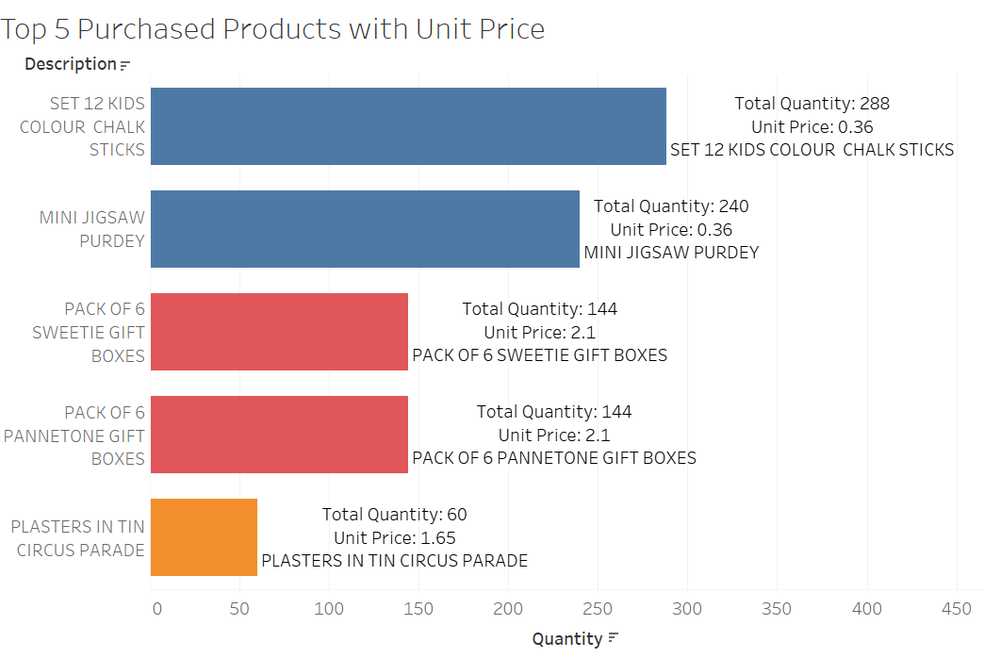
Visualization with Tableau (cont.)
Purchases related to a specific Country and other details:
Notes:
For the 3rd Hypothesis, I focused on random country similar Highest and Least. The example Country that I took was Austria. On the Right, we have the Invoice and Customer details based on the quantity purchased. This graph is unsorted and not comfortable to read. On the left, we have the graph that shows the Top 5 Products that are purchased along with the Description and Unit Price of Each Product

Slide 12
Lessons Learned
Complete utilization of proved data is not always possible
Need for Cleaning Data
Data Processing and Modifying
Need of Proper procedure for Visualization
Ineffective Visualization
Notes:
Complete utilization of proved data is not always possible. We had Stock Code which was not used in both Tableau and R. Null vales made it difficult for understanding UK Sales. So, it is important to clean and process the data. The last visualization had information but was not easy to read and understand. So it is important to follow proper technique and have a clear picture where a particular graph type is suitable to the given data or not.

